Slide 1
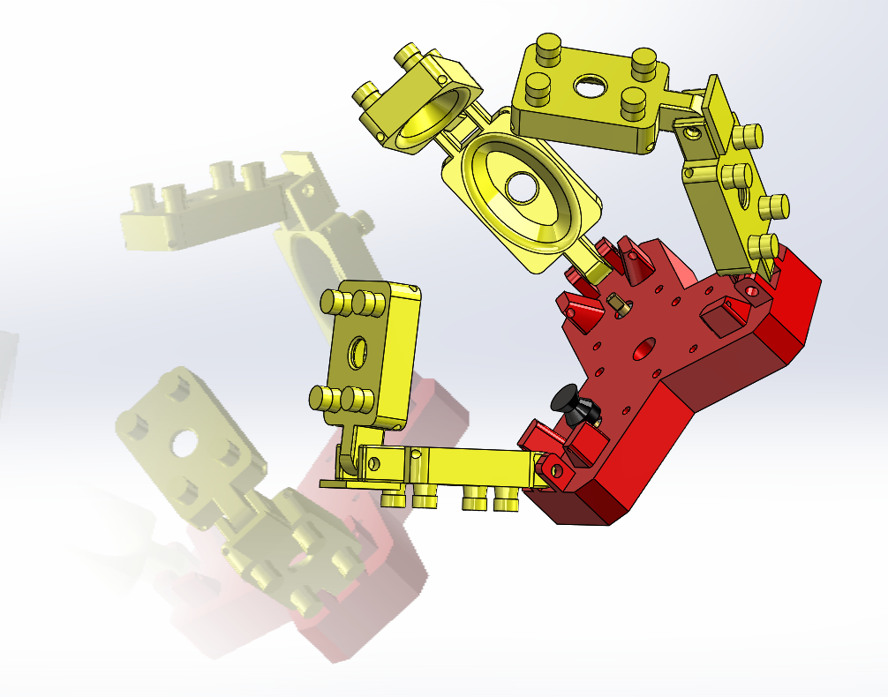
Soft Jamming Robotic Gripper
An alternative approach to a compliant .hand
Douglas Tilley & Liam Grazier

Slide 2
Why a hybrid?
Traditional grippers

Slide 3
Project Progress:
Task | 30/09/2018 | 07/10/2018 | 14/10/2018 | 21/10/2018 | 28/10/2018 | 04/11/2018 | 11/11/2018 | 18/11/2018 | 25/11/2018 | 02/12/2018 | 09/12/2018 | 11/12/2018
Initial Project Design
Preliminary Prototype of Digit
Materials Research and Eval
Motor Research and Requisition
Electronics Development
Rapid Prototyping + Development
Final Build + Intergration of all systems

Slide 4
Design Developments:
Finger development
2 link vs 3 link
It was found that through rapid prototyping that using 3 links caused collision conflicts.
The torque required by the motors to control 3 links was too much, whilst with 2 links it was actuatable.
3 links caused over rotation of the joint and hence without it was not possible to return the digit to the original position without another motor.2 link vs 3 link
asda
2 link vs 3 link

Slide 5
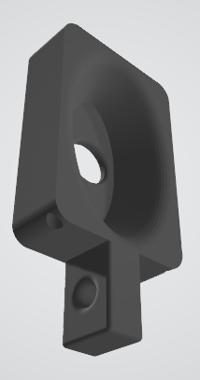
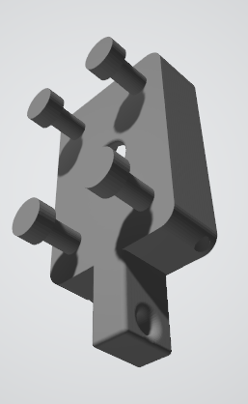
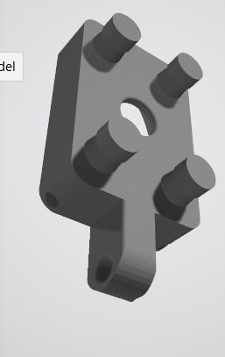
Prototype Developments:
The main developments from stage 1 of the design was adding rear posts to allow an elastic recoil.
Stage two added posts that were functional, but sadly not strong enough.
Stage three saw stronger posts added to the rear, these were much more suitable for this project

Slide 6
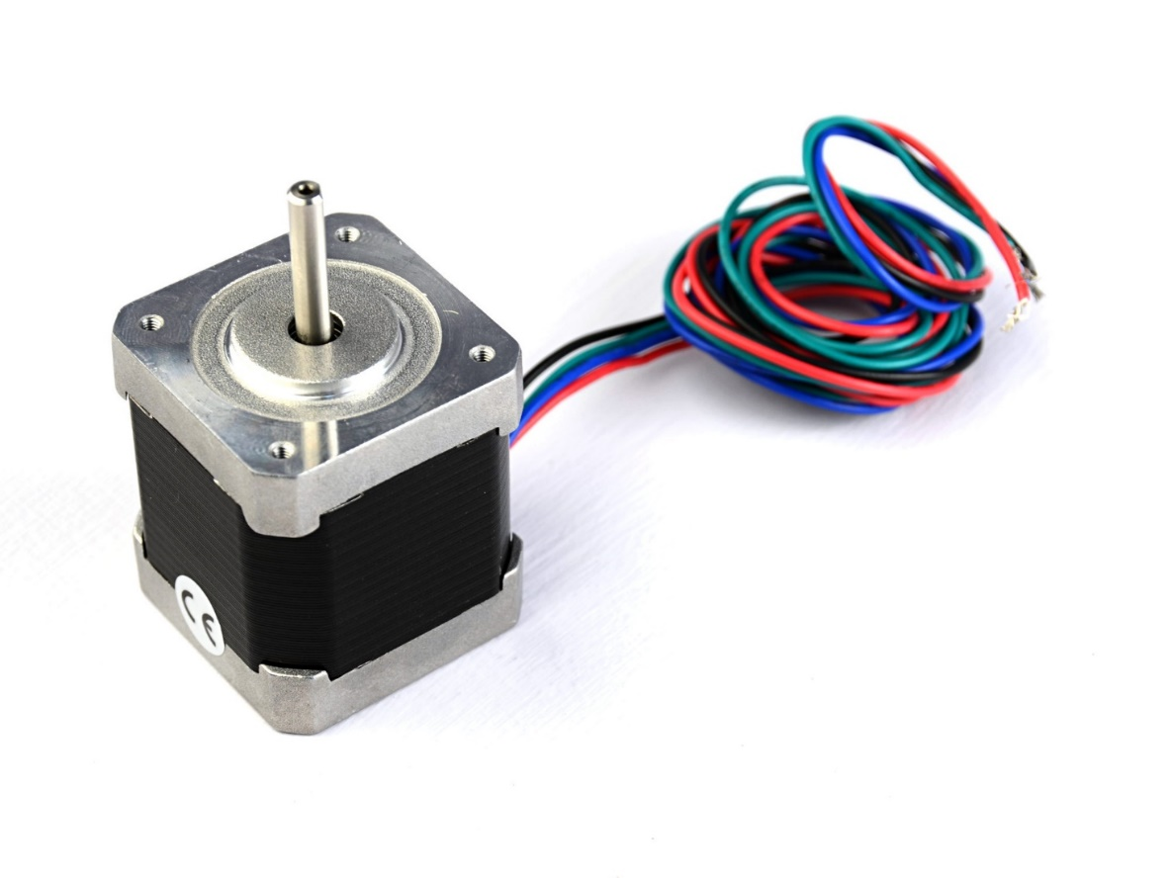
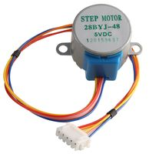
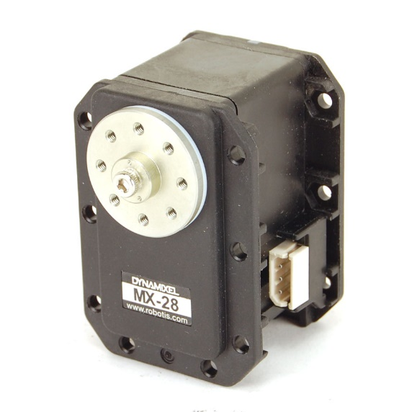
Electronic Developments:
Initially started using the MX-28
Developed RS-485 Circuit
Had issues controlling motors
Started developing low power stepper motor solution.
Multiple Stepper Motor Controller developed for six motors
Three for tendon control
Three for crushing control
Issue found using 28BYJ-28 stepper motors. Not powerful enough for either task, switched out for NEMA17 Stepper motors

Slide 7
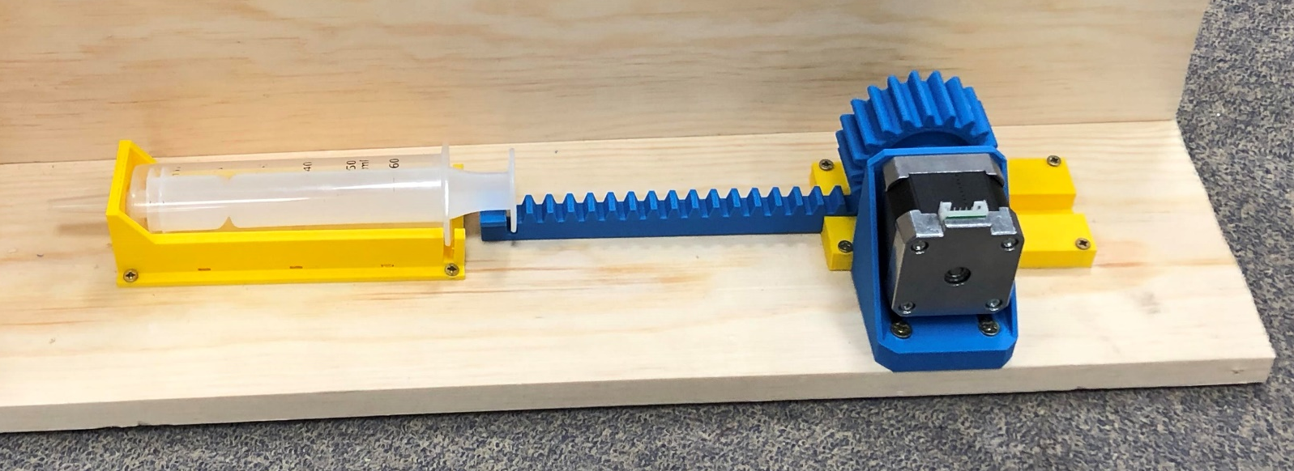
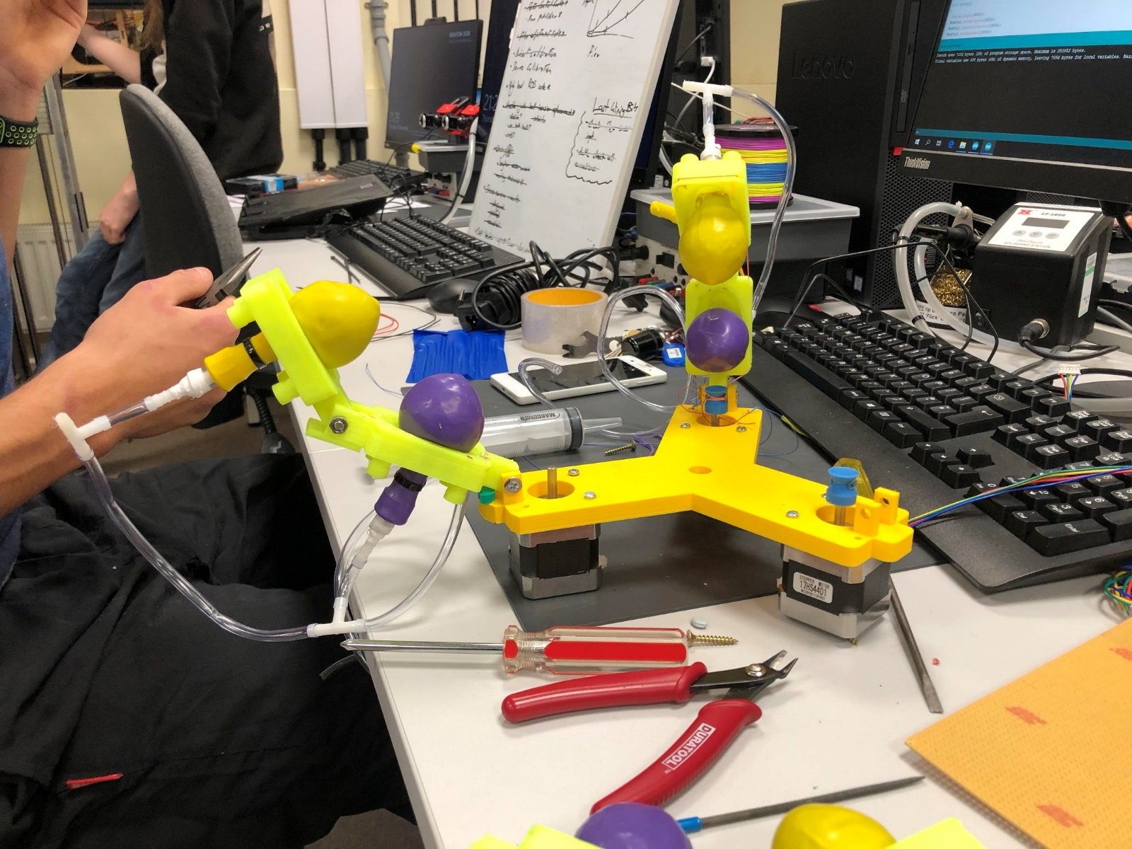
Project Development
Automated Syringe rack gearbox working, but due to low
Strength of the motors, there is not enough torque for the syringe
To draw air.
This would require a higher torque motor.
The prototype is on display. All the parts are ready for
Implementation upon purchase of higher strength motors.
The gripper has been reworked to integrate the NEMA 17s onto a new
Base plate. Old prototypes can be seen on the work bench.
Rapid prototyping using technologies such as 3D Printing, and laser cutting
All fuelled by CAD/CAM software, there has been many iterations of parts.
Digit (Singular Part) – 6
Bases (Singular Part) – 2
Pneumatic Rack (5 Part Assembly) – 1
Spindles (Singular Part) – 2

Slide 8
Prototype Testing

Slide 9
Code Developments

